Slide 1
NEPLOY
Designed and Developed By
Lokesh
Kaushik
Akshat Sachan
Raghavendra K

Slide 2
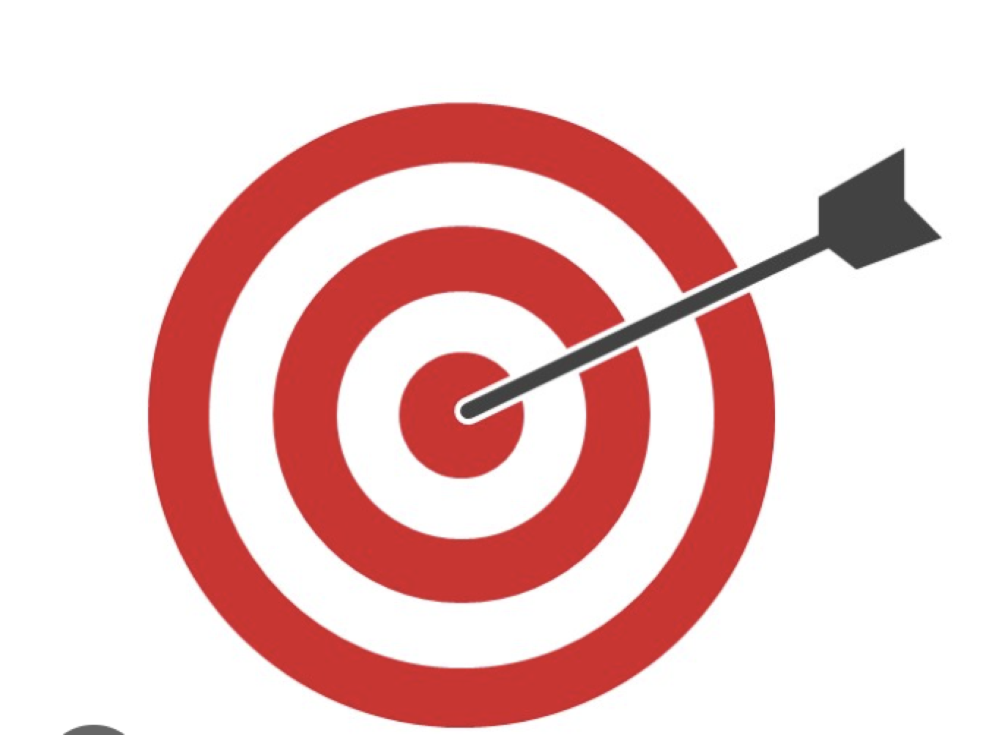
Project Objective
The intent and motive of the project is to develop the smart contract with DApp without hassle of build, depoly and test of smart contracts using kuberntes to containerize the environments and so that app expose endpoint to the user which user can run in the user interface and Code optimization ML model that suggest code improvement in the smart contract using python.

Slide 3
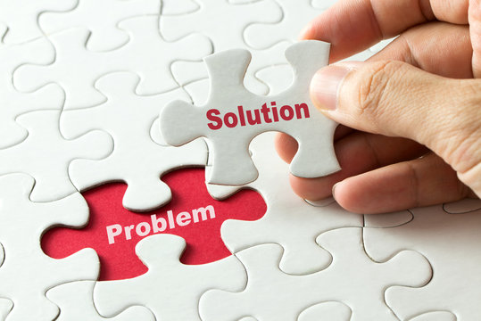
Solution Approach
Here are the steps involved in developing a smart contract with DApp without the hassle of build, deploy, and test of smart contracts using Kubernetes to containerize the environments and so that the app exposes an endpoint to the user which the user can run in the user interface, and a code optimization ML model that suggests code improvement in the smart contract using Python:
Choose a blockchain platform. The first step is a Neo N3 blockchain platform on which to develop smart contract. There are many different blockchain platforms available, each with its own strengths and weaknesses. Some popular options include Ethereum, Hyperledger Fabric, and Corda.
Create a smart contract. Once you have chosen a blockchain platform, you can create your smart contract. A smart contract is a piece of code that is stored on the blockchain and can be executed by anyone. Smart contracts can be used to automate a wide variety of tasks, such as transferring funds, exchanging assets, or managing contracts.
Deploy the smart contract. Once you have created your smart contract, you need to deploy it to the blockchain. This process varies depending on the blockchain platform you are using.

Slide 4
Solution Approach
Create a DApp. A DApp is a decentralized application that runs on the blockchain. DApps can be used to interact with smart contracts and other decentralized services.
Containerize the environments. Kubernetes is a container orchestration platform that can be used to manage the deployment and scaling of DApps. Kubernetes can help to ensure that your DApp is always available and running smoothly.
Expose an endpoint to the user. Once you have containerized the environments, you need to expose an endpoint to the user. This endpoint will allow users to interact with your DApp.
Develop a code optimization ML model. This model will be used to suggest code improvements in the smart contract. The model can be developed using Python, and it can be trained on a dataset of smart contracts.

Slide 5

Value Added Features
Here are some additional things to keep in mind when developing a smart contract with DApp using Kubernetes and a code optimization ML model:
Security: It is important to take security measures to protect your smart contract and DApp. This includes using secure coding practices and encrypting data.
Scalability: Kubernetes can help to ensure that your DApp is scalable. This means that it can handle a large number of users and transactions.
Maintainability: Kubernetes can help to make your DApp more maintainable. This means that it is easier to update and fix bugs.
Code optimization: The code optimization ML model can help to improve the performance and efficiency of your smart contract. This can make your DApp more user-friendly and reliable.

Slide 6
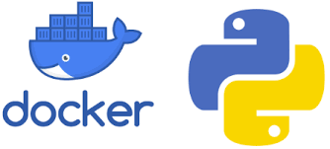
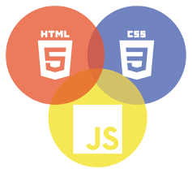
Technology Stack
Machine Learning
Python
JavaScript
CSS
HTML
Dockerfile

